Slide 1
MODERATION
Connor McCabe
Psychology 523/525

Slide 2
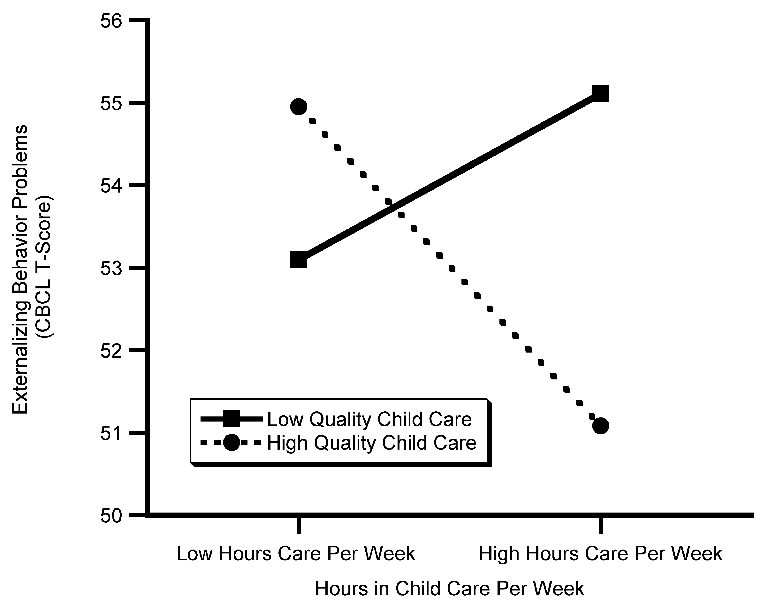
Moderation: The effect of one variable on an outcome differs across levels of one (or more) other variable.

Slide 3
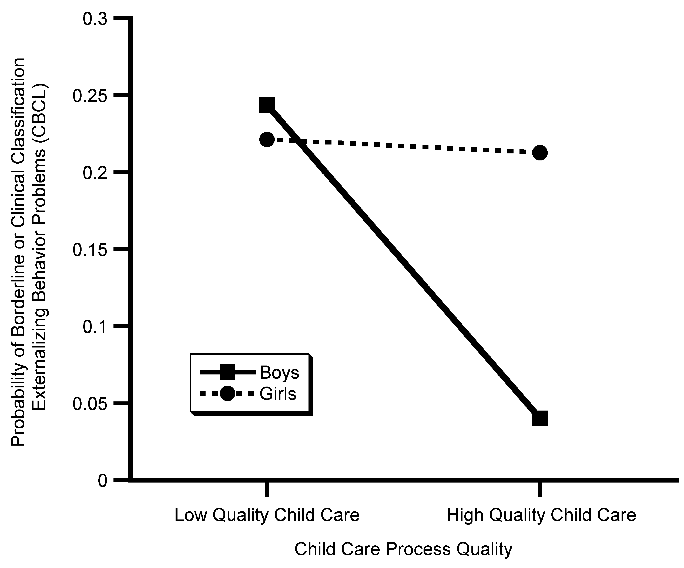
A moderator can be categorical or continuous.

Slide 4
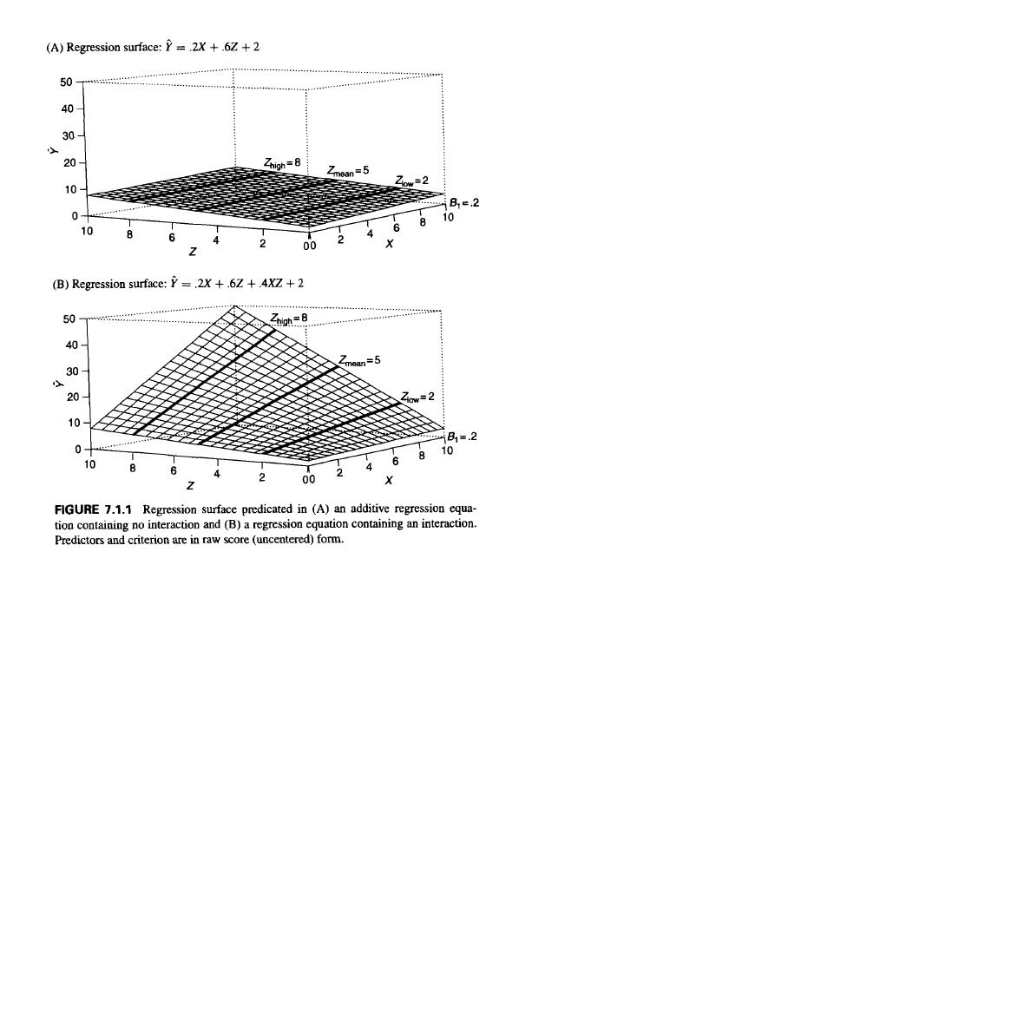
Interactions test the curvature of a regression plane.
No interaction (additive model):
Interaction:
Notes:
Additive effects
Predictors X and Z form the axis on the floor of the graph, all 36 cases (every combination of predictor variables) lie of the floor
Predicted Yhat for each cases are generate from the regression equation,
The regression plan is the tiled plane above the floor represents the location of Yhat for ever possible combination of values of X and Z
Note that the plant is flat, regardless of the particular combination for X and Z Y is incremented by a constant value relative to the values of X and Z, that is by the value .2X+.6Z

Slide 5
OLS assumptions imply that no interactions exist in a model (unless otherwise specified).
B₁(15*X) is the (first-order) effect of X on Y, and will be the same at all levels of Z.
The effect of X on Y now depends on both B1 and B3.
15*X is now the effect only when Z is zero.
Y = 40 + 15*X + 11*Z
Y = (40 + 11*Z) + (15 + 10*Z)*X

Slide 6
The nature of an interaction may take multiple forms.
This depends on the direction of the first-order (main effects) and higher-order (interaction) coefficients.
Synergistic – both predictors are of the same sign, and together produce a stronger effect than either alone
Buffering – one predictor weakens the effect of the other
Antagonistic – both predictors affect the outcome in the same way, but the interaction is the opposite sign
Y = 40 + 15*X + 11*Z + 10*(X*Z)
Y = 40 + 15*X - 11*Z - 10*(X*Z)
Y = 40 + 15*X + 11*Z - 10*(X*Z)

Slide 7
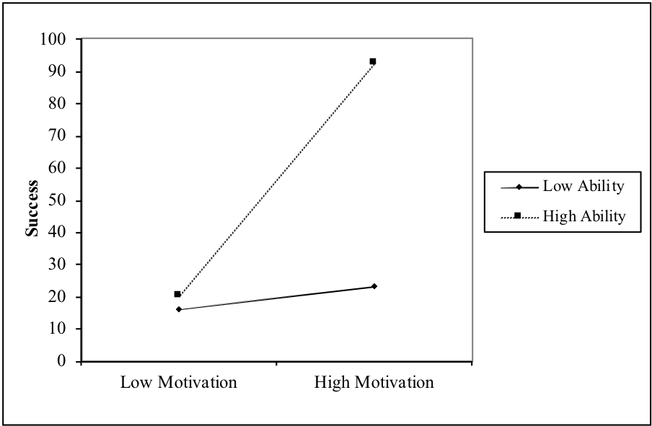
Example: motivation, ability, and success in graduate school (!)
Success = 40 + 22*motivation + 17.5*ability + 17*(motivation*ability)
How might I describe this effect?

Slide 8
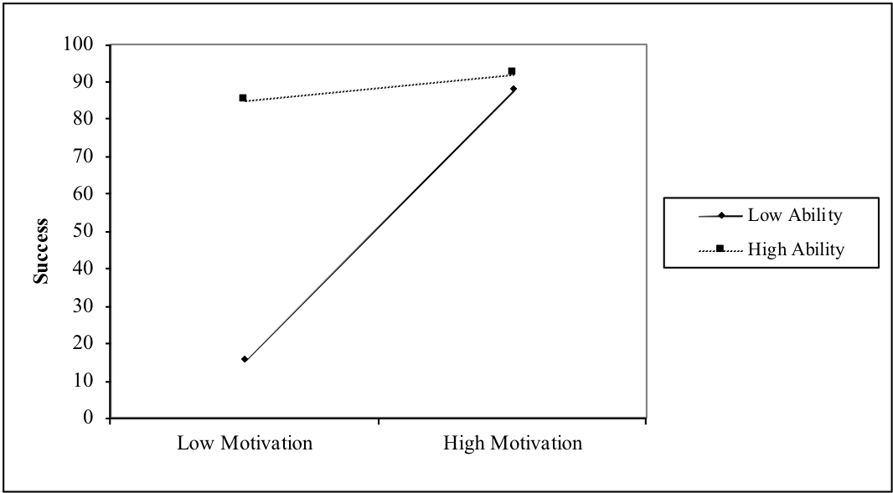
Example: motivation, ability, and success in graduate school (!)
Success = 70 + 22*motivation + 17.5*ability - 17*(motivation*ability)
How might I describe this effect?

Slide 9
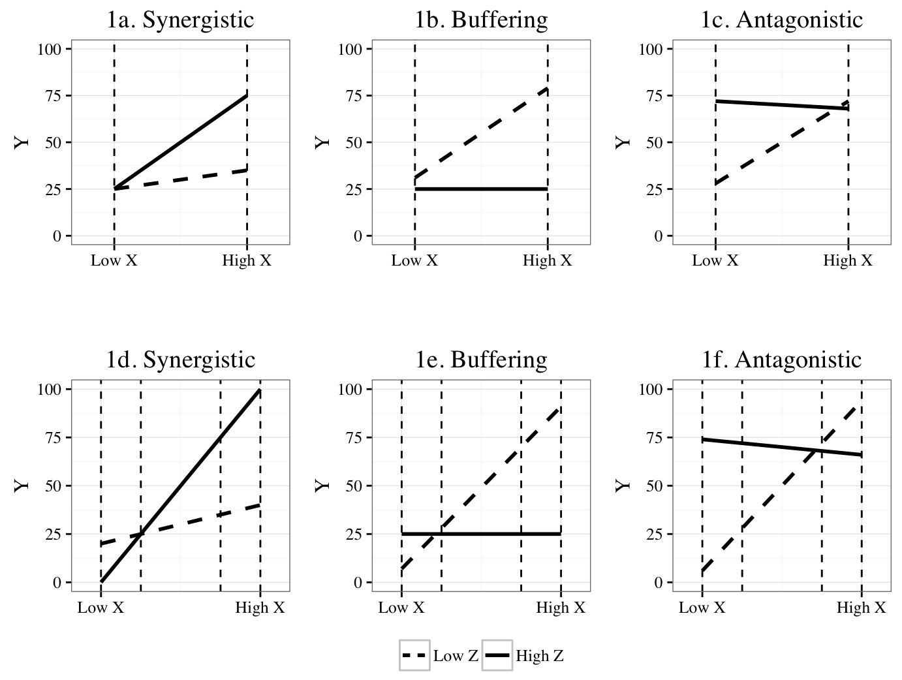
The nature of an interaction may take multiple forms.
Ordinal – the rank-ordering of the values of Y are the same across all levels of X.
Disordinal (crossover) – The rank-ordering of Y changes across levels of X.
  I.e., the lines cross.
Ordinal
Disordinal

Slide 10
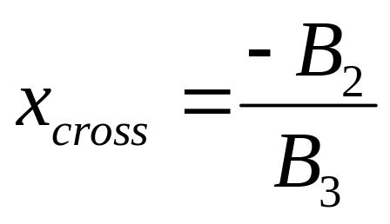
ALL interactions are disordinal at an infinite range of X and Z
The crossover point for an interaction can be computed as follows:
BUT, this must be considered within the range of observed data.
Notes:
The value of which lines cross at x. B2 is the moderation coefficient and B3 is the interaction coefficient

Slide 11
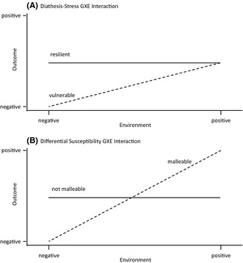
Example: Diathesis stress versus biological sensitivity to context
Roisman et al., 2012; Belsky, Pluess, & Widaman, 2013
Notes:
Recommended reading on why ordinal and disordinal

Slide 12
Today: interactions with a categorical moderator
A researcher is interested in determining whether the relation between number of publications and salary differs among psychology versus non-psychology faculty.
Salary = B0 + B1(psych) + B2(pubs) + B3(pubs*psych)

Slide 13
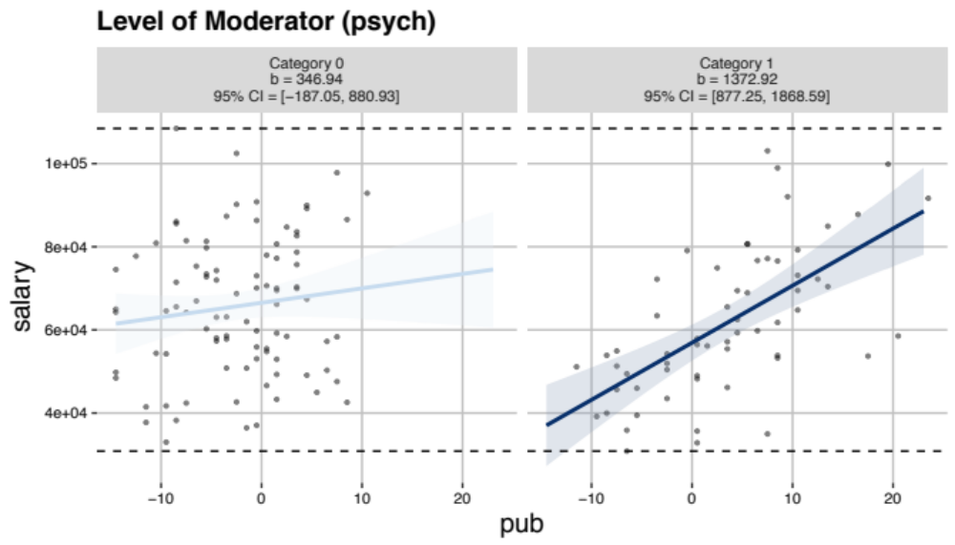
Today: interactions with a categorical moderator

Slide 14
Today: interactions with a categorical moderator
Assume we obtain the following results:
Salary = 61148.8 - 25492(psych) + 346.9(pubs) + 1026(pubs*psych)

Slide 15
Rearranging the formula:
Salary = (61148.8 - 25492(psych)) +
(346.9 + 1026(psych))*pubs

Slide 16
Rearranging the formula:
When psych=0 (that is, among non-psychology departments):
Salary_{non-psychology} = (61148.8 – 25492*0) +
(346.9 + 1026*0)*pubs
Salary_{non-psychology} = (61148.8) + (346.9)*pubs

Slide 17
Rearranging the formula:
When psych=1 (that is, among psychology departments):
Salary_{psychology} = (61148.8 – 25492*1) +
(346.9 + 1026*1)*pubs
Salary_{psychology} = (35656.8) + (1372.9)*pubs

Slide 18
How do these translate to the plot?
Salary_{non-psychology} = (61148.8) + (346.9)*pubs
Salary_{psychology} = (35656.8) + (1372.9)*pubs

Slide 19
Let’s switch to R
In R, here’s what we’ll be showing:
  Do not split your data to test moderation.
  Specifying an interaction term in R is actually really easy.
  Use re-centering to “probe” an interaction.
        This is actually pretty easy too with a categorical moderator.

Slide 20
Centering, revisited
In additive models, centering helped facilitate the interpretation of our intercept.
Without an interaction term, no other coefficients will change.

Slide 21
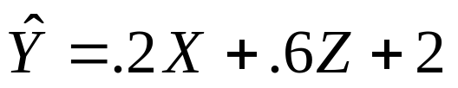
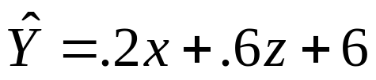
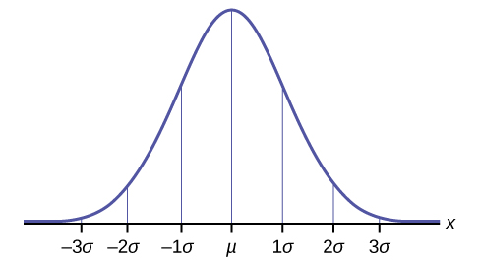

Example
6
2
.2

Slide 22
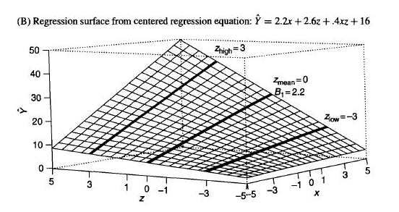
Centering, revisited
When an interaction term is included, centering (at the mean) provides us with estimate of each coefficient when each predictor is at the mean.
It is strongly recommended that you center predictor variables beforehand when testing interactions!

Slide 23
Grad success example: using uncentered predictors
df<-read.csv("~/Desktop/525_interact_ex.csv")
#Interaction, uncentered
m2.uncen<-lm(success ~ motivation + ability + motivation*ability, df)
summary(m2.uncen)
 | Estimate | Std. Error | t value | Pr(>|t|)
motivation | -30.67 | 11.9 | -2.578 | 0.01094
ability | -52.18 | 15.07 | -3.461 | 0.0007052
motivation:ability | 17.11 | 3.668 | 4.665 | 6.92E-06
(Intercept) | 109.3 | 45.89 | 2.382 | 0.01852

Slide 24
Grad success example: using centered predictors
#Interaction, centered
m2.cen<-lm(success~scale(motivation,scale=F) +
scale(ability,scale=F) +
scale(motivation,scale=F)*scale(ability,scale=F), df)
pander(summary(m2.cen))
 | Estimate | Std. Error | t value | Pr(>|t|)
scale(motivation, scale = F) | 22.17 | 4.743 | 4.673 | 6.68E-06
scale(ability, scale = F) | 17.29 | 4.001 | 4.321 | 2.85E-05
scale(motivation, scale = F):scale(ability, scale = F) | 17.11 | 3.668 | 4.665 | 6.92E-06
(Intercept) | 38.15 | 4.109 | 9.284 | 2.09E-16

Slide 25
How to center in SPSS
AGGREGATE
/OUTFILE=* MODE=ADDVARIABLES OVERWRITE=YES
/BREAK=allmean
/motivation_mean=MEAN(motivation)
/ability_mean=MEAN(ability).
compute motivationc = motivation - motivation_mean.
compute abilityc = ability - ability_mean.
compute MxA = motivationc*abilityc.
execute.
variable labels motivationc 'Motivation to acheive in school, mean centered'.
variable labels abilityc 'Ability as a student, mean centered'.
variable labels MxA 'motivation*ability'.

Slide 26
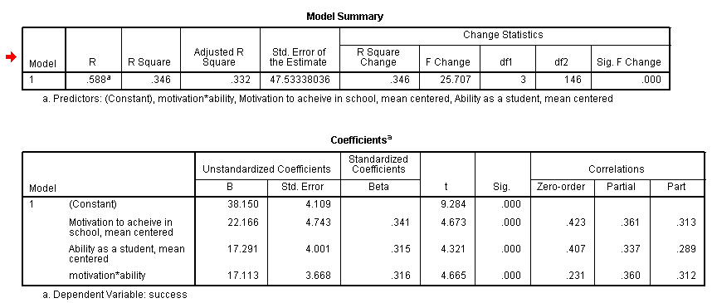
Replicating results in SPSS
REGRESSION
/STATISTICS COEFF R CHA ZPP
/DEPENDENT success
/METHOD = ENTER motivationc abilityc MXA.

Slide 27
This concept can be leveraged to probe an interaction effect.
The interpretation of a given coefficient in regression will always be interpreted as the effect when all other predictors are at zero.
We can therefore change the value of zero of our moderator (using centering) to better understand what an interaction means.
This is called the pick-a-point approach (Aiken & West, 1991).
  Typically, this is conducted at +/- 1 standard deviation from the mean of the moderator.
  If I were to re-center around 1 SD below the mean, what transformation of X would I need to do to achieve this?
Testing significance of the coefficient of the focal (X) predictor at these given levels of the moderator (Z) predictor is called simple slopes analysis
Notes:
Start here on 2.16

Slide 28

Example: Where is my predictor now?

Slide 29

Example: Where is my predictor now?

Slide 30
Pick-a-point method in R
center<-function(MOD)
{
centered<-MOD-mean(MOD,na.rm=TRUE)
return(centered)
}
probe.low.1sd<-function(MOD)
{
low<-(MOD-mean(MOD,na.rm=TRUE))+sd(MOD, na.rm=TRUE)
return(low)
}
probe.high.1sd<-function(MOD)
{
high<-(MOD-mean(MOD, na.rm=TRUE))-sd(MOD, na.rm=TRUE)
return(high)
}

Slide 31
Pick-a-point method in R
#Mean centered
m2.cencm<-lm(success~center(motivation) + center(ability) + center(motivation)*center(ability), df)
#Probing at 1SD below the mean of ability
m2.low<-lm(success~center(motivation) + probe.low.1sd(ability) + center(motivation)*probe.low.1sd(ability), df)
#Probing at 1 SD above the mean of ability
m2.high<-lm(success~center(motivation) + probe.high.1sd(ability) + center(motivation)*probe.high.1sd(ability), df)

Slide 32
Pick-a-point method in SPSS
compute allsd=1.
execute.
AGGREGATE
/OUTFILE=* MODE=ADDVARIABLES
/BREAK=allsd
/motivation_sd=SD(motivation)
/ability_sd=SD(ability).
compute abilityc_HIGH =abilityc - ability_sd.
compute abilityc_LOW = abilityc + ability_sd.
compute MxA_LOW = motivationc*abilityc_LOW.
compute MxA_HIGH = motivationc*abilityc_HIGH.
execute.
variable labels abilityc_HIGH ‘HIGH ability (+1 SD)’.
variable labels abilityc_LOW ‘LOW ability (+1 SD)’.
variable labels MxA_LOW 'motivation*ability, ability LOW'.
variable labels MxA_HIGH 'motivation*ability, ability, HIGH'.

Slide 33
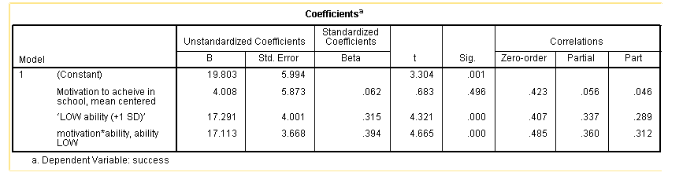
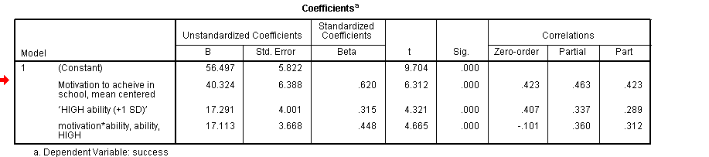
Pick-a-point method in SPSS

Slide 34
This method also applies to categorical variable interactions.
Does the effect of motivation on success in graduate school differ based on prior education (public versus private schooling)?
Success = 21.98 - .91*motivation + 26.46*private + 46.5*(motivation*private)
*motivation centered in this example
Notes:
motiva

Slide 35
Pick-a-point take-home points
Summarizes the nature of the interaction at specific points of a moderator (typically +- 1 SD)
Re-centering around different values can tell us specifically about the nature of a given interaction (e.g., buffering, synergistic, antagonistic).
For categorical variable interactions, simply change the reference category of your moderator (e.g., change the zero point).
Limitations
  There is nothing special about +- 1 SD. You may miss the fact that an effect actually reverses in direction!
  E.g., what if you have REALLY high or REALLY low ability (+- 2 SD)?

Slide 36
Regions-of-significance approach
In essence, conducts a pick-a-point analysis across the FULL RANGE of the moderating variable
Determines at what level(s) of the moderator the focal predictor is significantly related to the outcome
Utility: http://quantpsy.org/interact/mlr2.htm

Slide 37
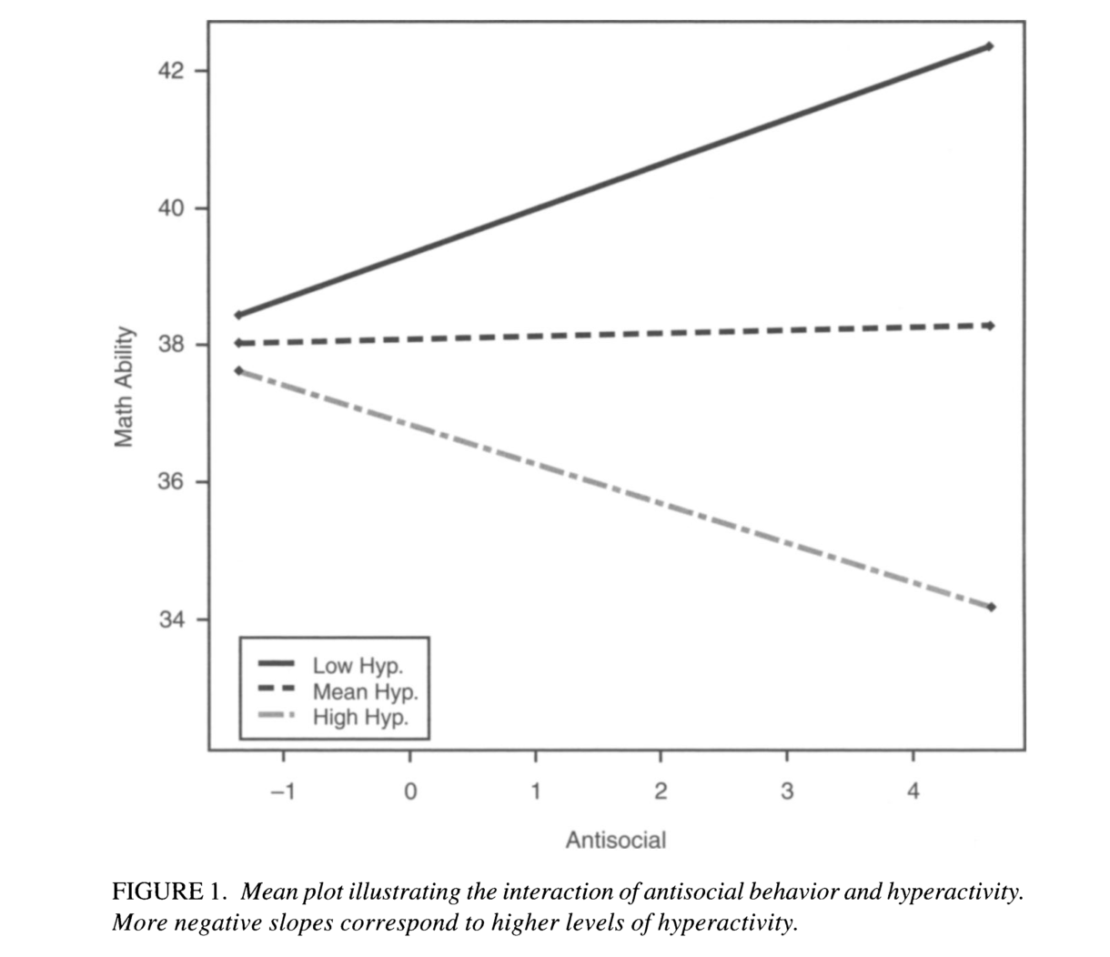
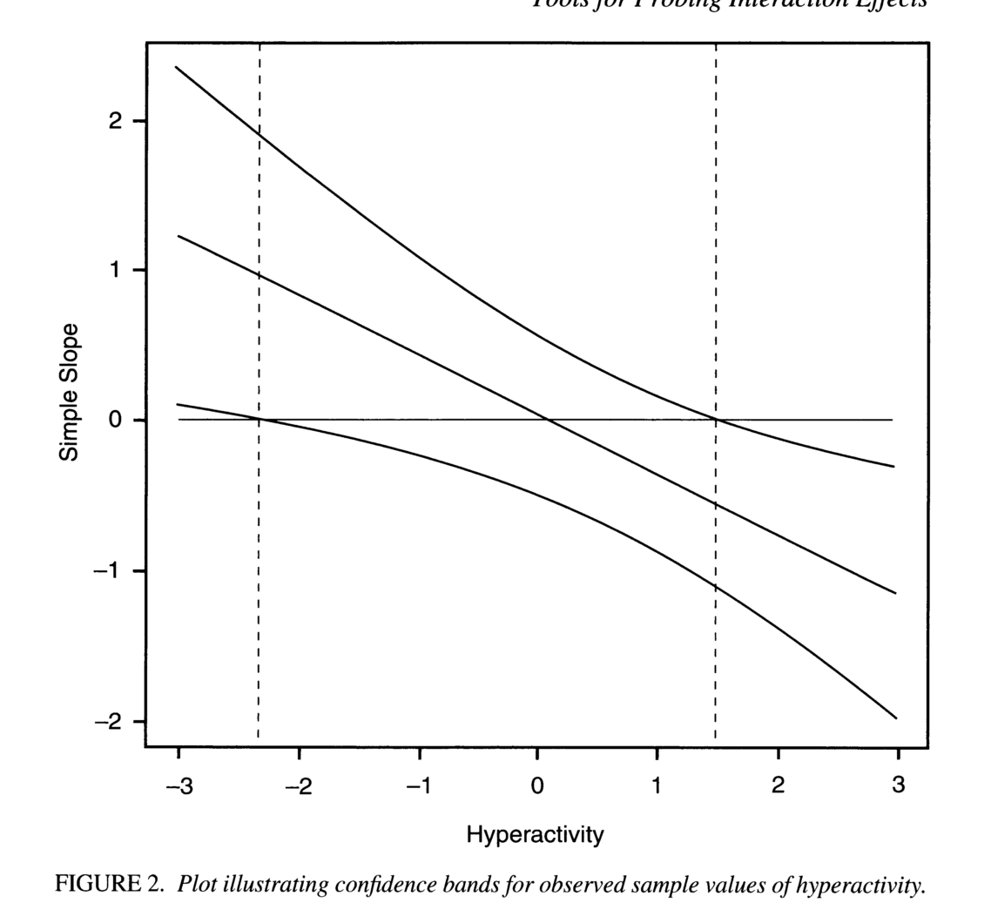
Regions-of-significance approach
The effect of antisociality on math ability is significant and positive at about 2.3 SDs below the mean of hyperactivity or lower, and significant and negative at 1.5 SDs above the mean of hyperactivity or higher.*
Preacher, Curran, Bauer, 2006

Slide 38
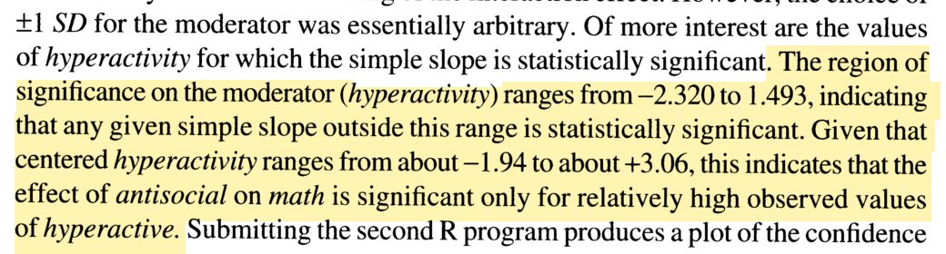
Regions-of-significance approach

Slide 39
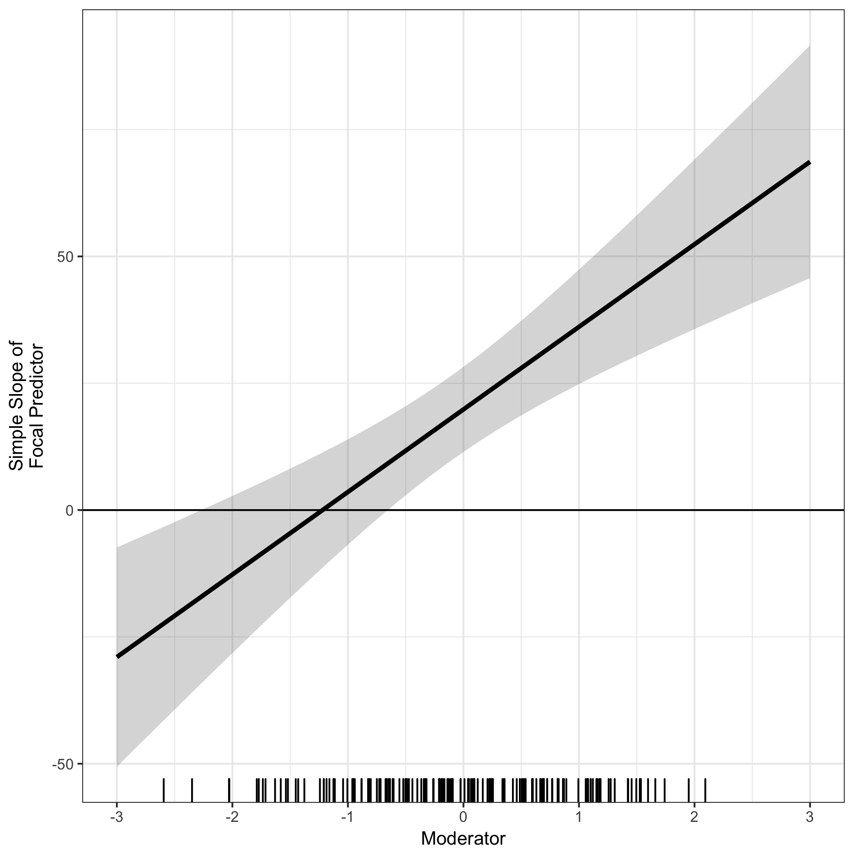
General recommendation: plot your observed data.

Slide 40
